Slide 1
Part I: Raw Data Plot
Last Edited 07/14/2019

Slide 2
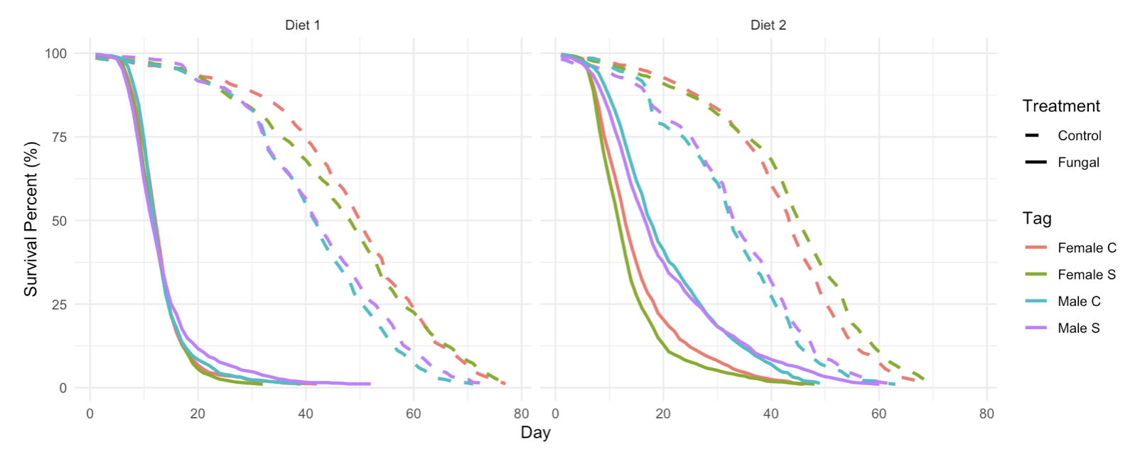
Population Replicates Combined

Slide 3
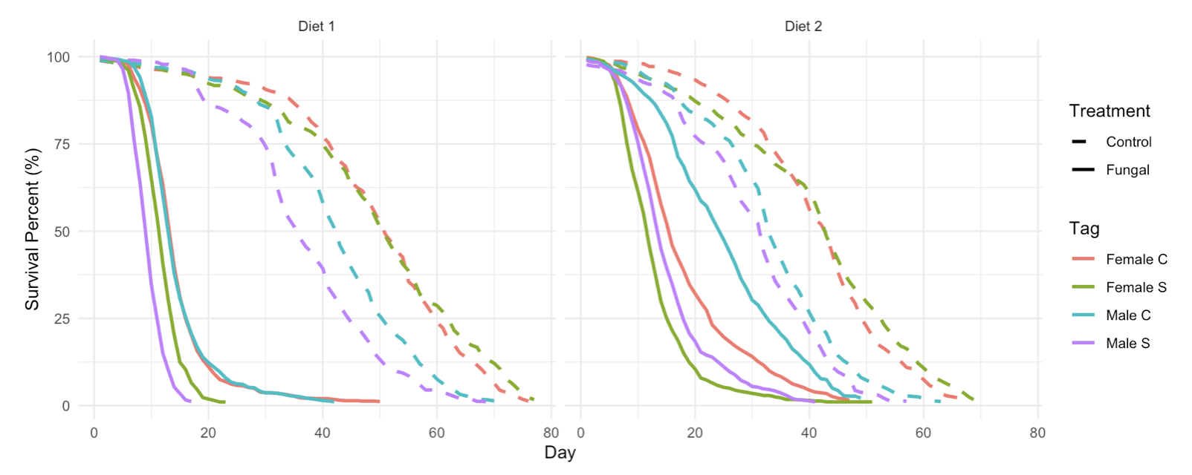
Population Replicate 1

Slide 4
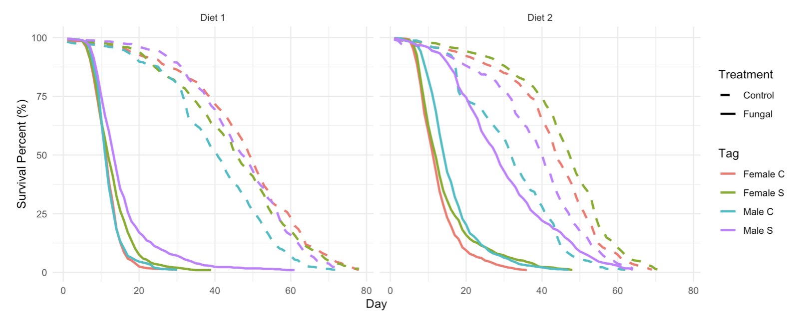
Population Replicate 2

Slide 5
Part II: Cox Model
Last Edited 08/19/2019

Slide 6
Cox Model Formula

Slide 7
Cox Model Coefficients

Slide 8
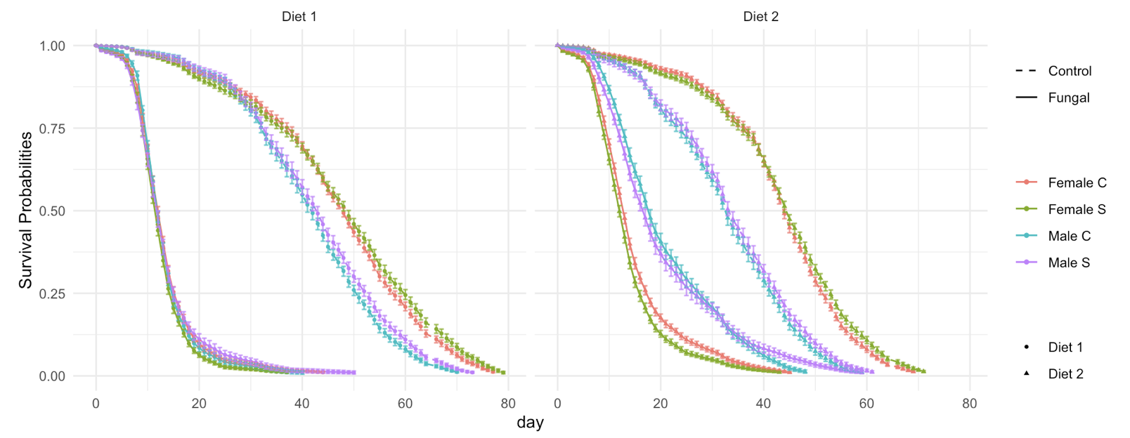
Survival Probabilities
Bootstrap: 200 iterations

Slide 9
Hazard Ratio Tables
Treatment | Sex | Diet | Hazard ratios between populations | 0 – 8 | 8 – 16 | 16 – 25 | 25 – 38 | 38 – End
Control | Male | Diet 1 | C vs S (p-value)
Control | Male | Diet 2 | C vs S (p-value)
Control | Female | Diet 1 | C vs S (p-value)
Control | Female | Diet 2 | C vs S (p-value)
Fungal | Male | Diet 1 | C vs S (p-value)
Fungal | Male | Diet 2 | C vs S (p-value)
Fungal | Female | Diet 1 | C vs S (p-value)
Fungal | Female | Diet 2 | C vs S (p-value)

